Slide 1
Please tell us in the chat window what your name is, if you have preferred pronouns, and where you are located.
WELCOME TO
THE SCHOOL
FOR LIFE: UNDERSTANDING
N.F.S GRUNDTVIG

Slide 2
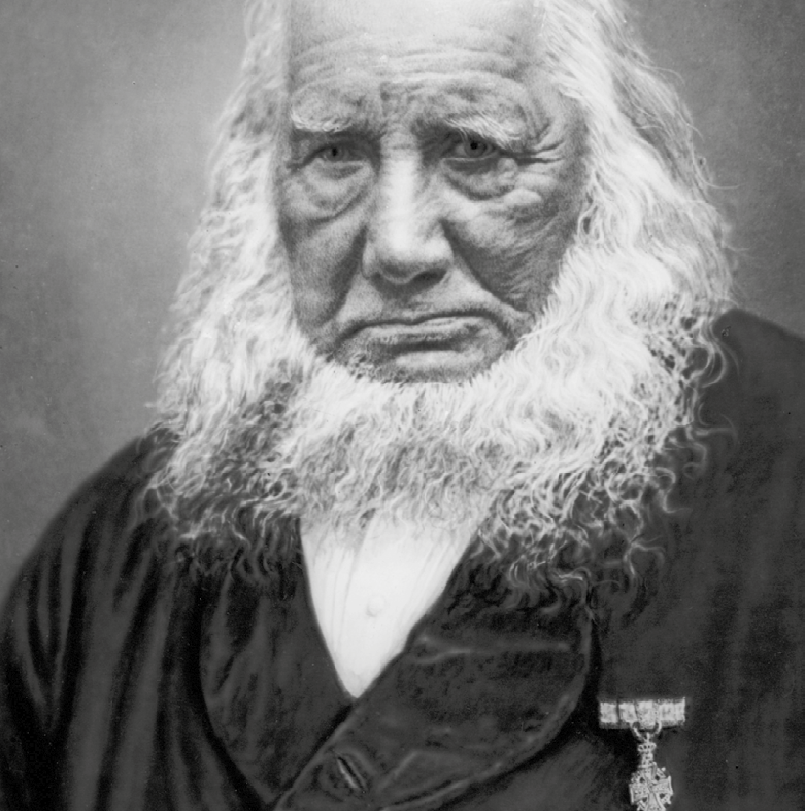
THE SCHOOL
FOR LIFE: UNDERSTANDING
N.F.S GRUNDTVIG
ANDERS HOLM
Hosted by: Dawn Jackman Murphy, FEAA VP
Jerry Jackson, FEAA President

Slide 3
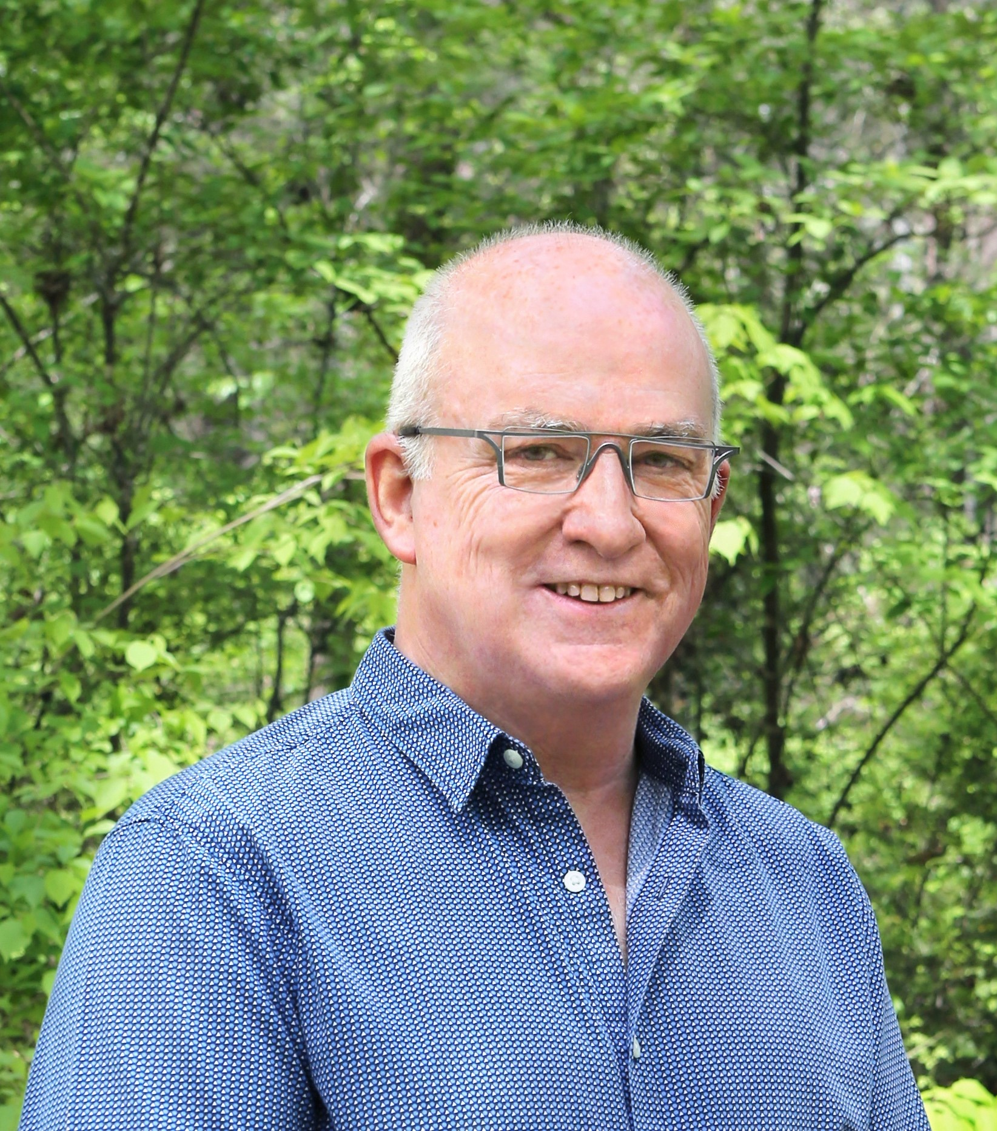
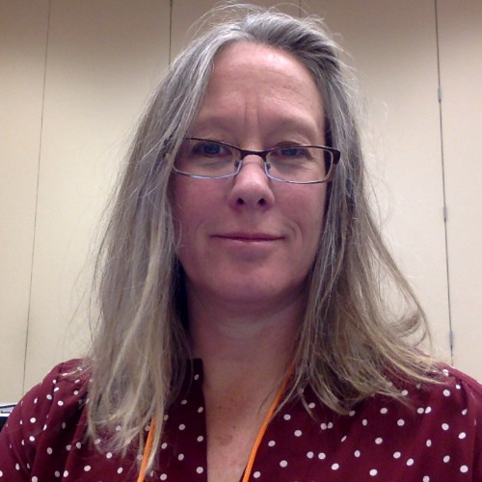
HOSTS
Jerry Jackson
President of Folk Education Association of America
Dawn Jackman Murphy
VP of Folk Education Association of America

Slide 4
This webinar is funded by the Office of Research and Evaluation at AmeriCorps under Grant No. 22REACA001 through the National Service and Civic Engagement research grant competition. Opinions or points of view expressed in this webinar are those of the authors and do not necessarily reflect the official position of, or a position that is endorsed by, AmeriCorps.
WEBINAR DISCLAIMER:
The law requires consent prior to recording a person’s participation in an event. Please be advised that your image will be captured and recorded during the webinar. Your participation in this webinar equals consent to be recorded as required by law. If you do not consent to being recorded, but choose to participate, please turn your camera off and use the chat feature to interact with the speakers. You may also disconnect now.

Slide 5
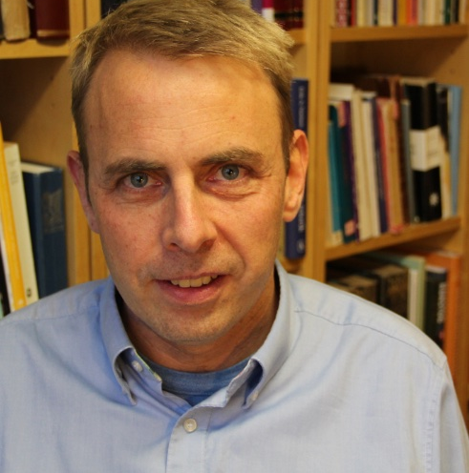
SPEAKER: ANDERS HOLM
University of Copenhagen

Slide 6
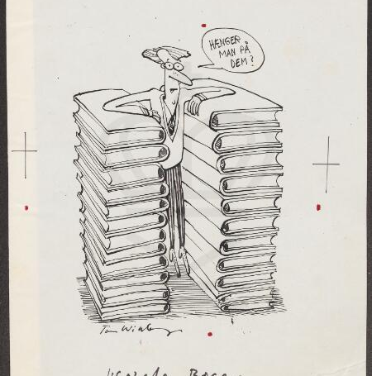
150 Books of 500 Pages

Slide 7
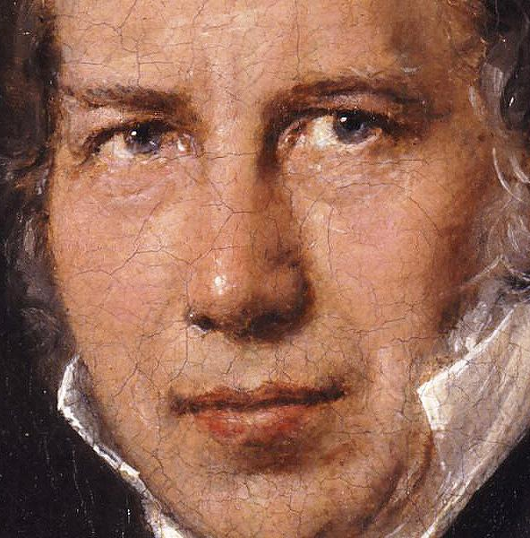
OUTLINES OF THE PRESENTATION
Grundtvig’s Life
A. The Romantic
B. The Mythologist
C. The Pastor and Hymn Writer
E. The Historian
F. The Educator
G. The Politician
2. Grundtvig Worldwide
Does he matter today?

Slide 8
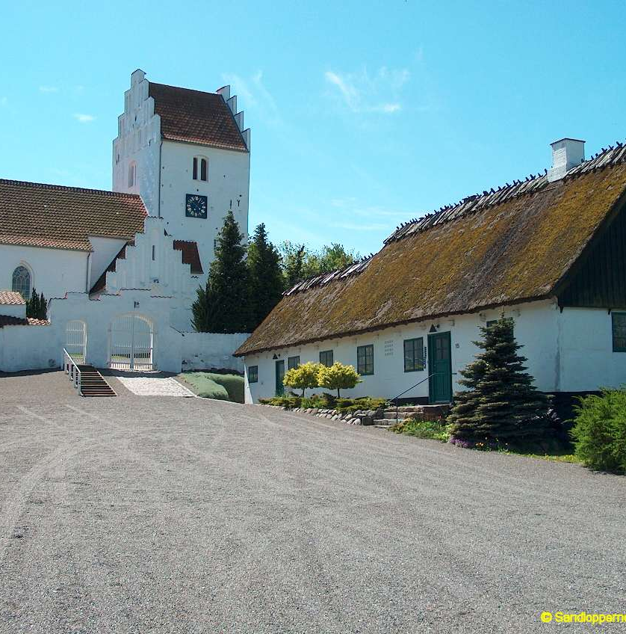
GRUNDTVIG’S LIFE
Grundtvig was born in Udby in 1783

Slide 9
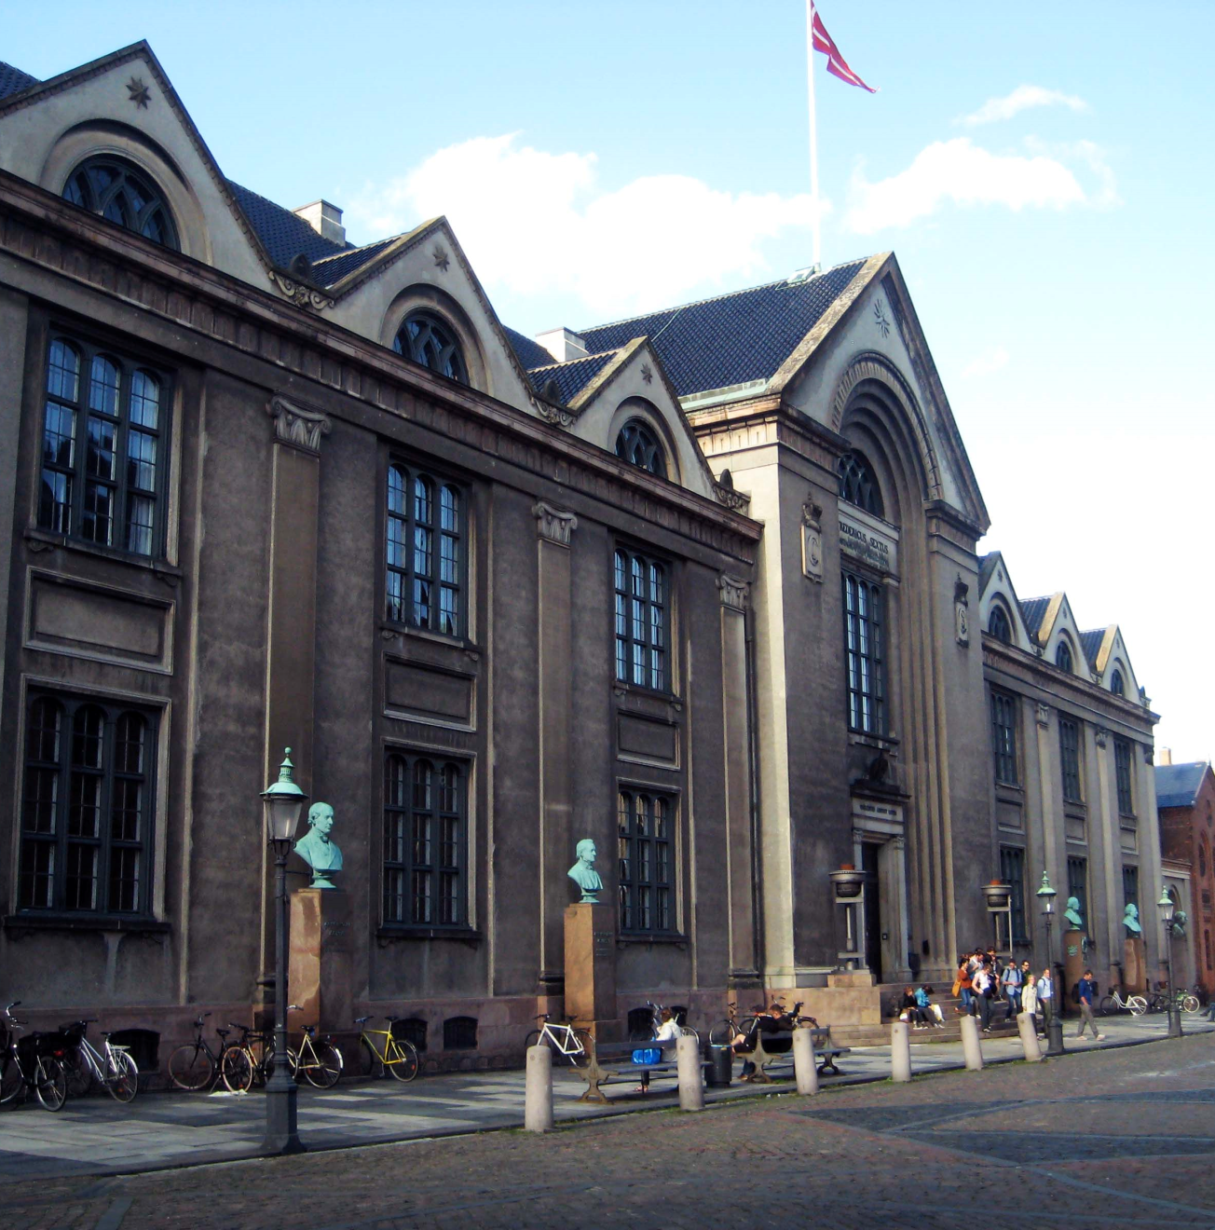
GRUNDTVIG STUDIED THEOLOGY AT UNIVERSITY OF COPENHAGEN
BETWEEN 1800 AND 1803

Slide 10
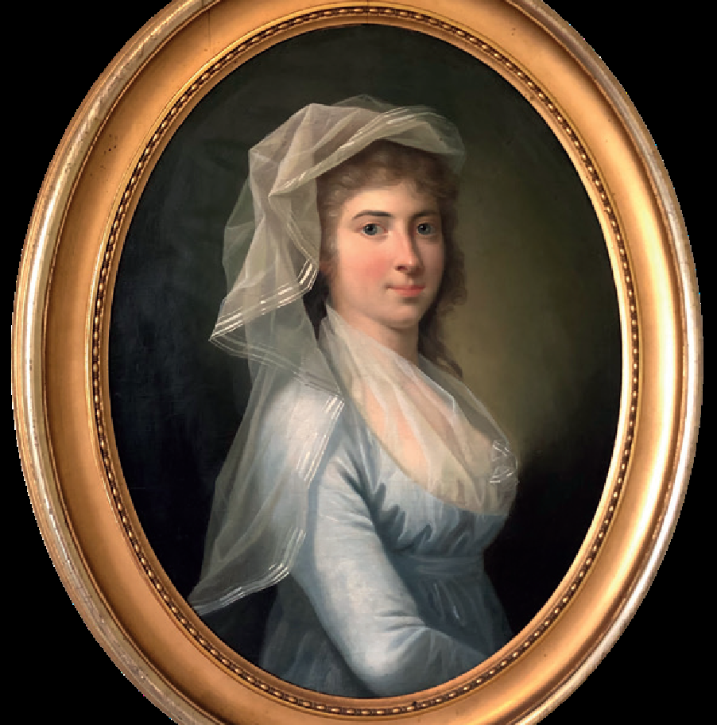
THE ROMANTIC
“Imagination and the emotions are just as much a part of a true human being as reason!”
(Grundtvig 1834)
Constance Leth

Slide 11
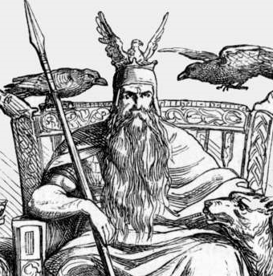
THE MYTHOLOGIST
“A belief in the great importance of Nordic mythology is an integral part of my being.”
(Grundtvig in Mythology
of the North 1808)

Slide 12
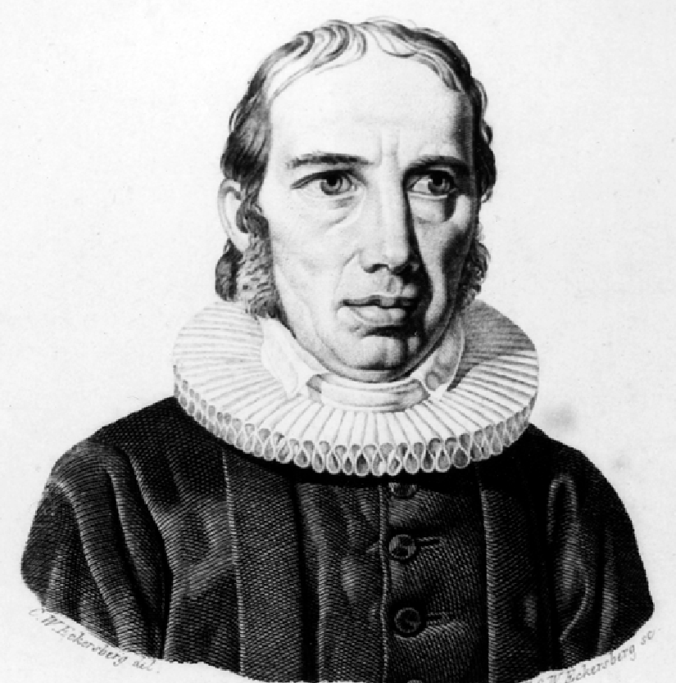
THE PASTOR AND HYMN WRITER
“Human comes first,
and Christian next.”
(Grundtvig 1837)

Slide 13
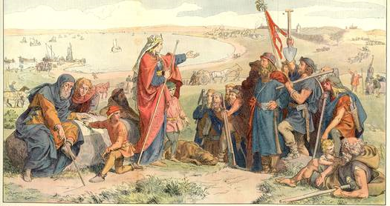
“History is the life of the human race” (Grundtvig 1859)
THE HISTORIAN

Slide 14
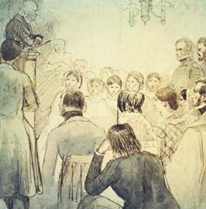
THE EDUCATOR
The Folk School.
The People’s School.
The School for Life!
“We can and must all become educated and useful citizens.”
(Grundtvig 1838)

Slide 15
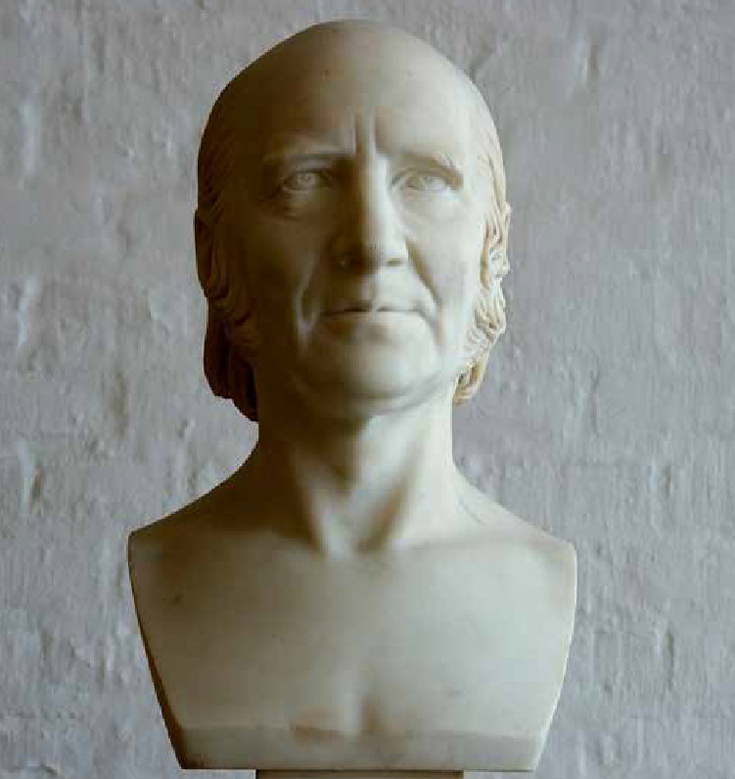
THE POLITICIAN
“Whoever wishes to be free must allow his neighbour to be so too.”
(Grundtvig 1838)

Slide 16
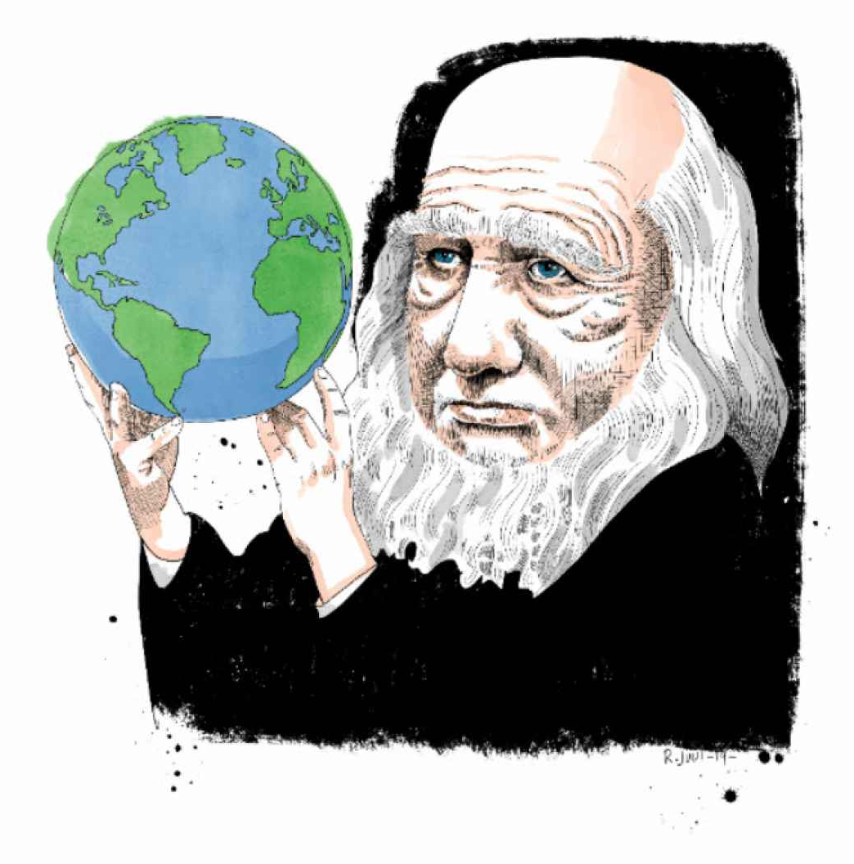
GRUNDTVIG WORLDWIDE

Slide 17
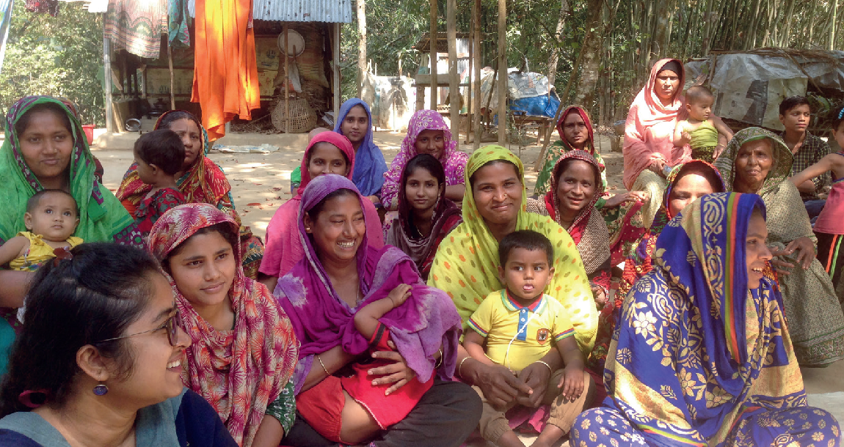
The People’s School in Bangladesh

Slide 18
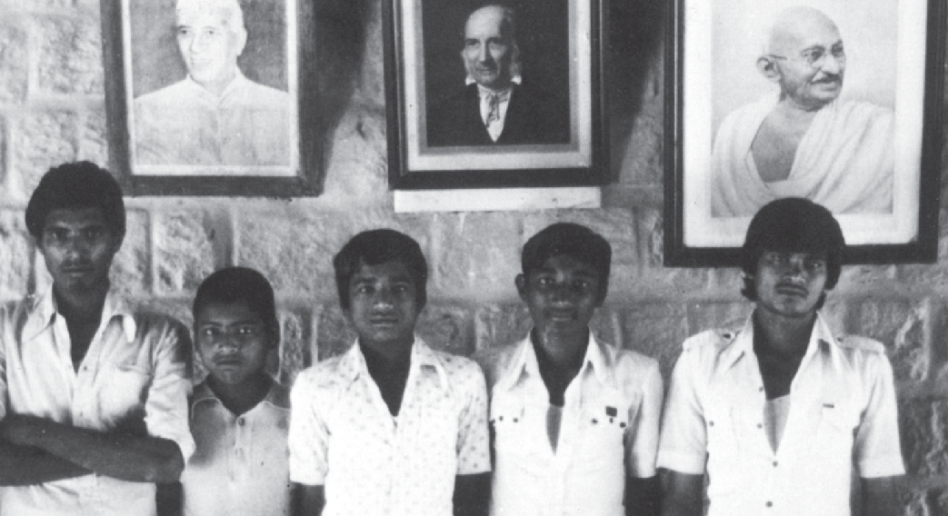
The People’s School in Bangladesh

Slide 19
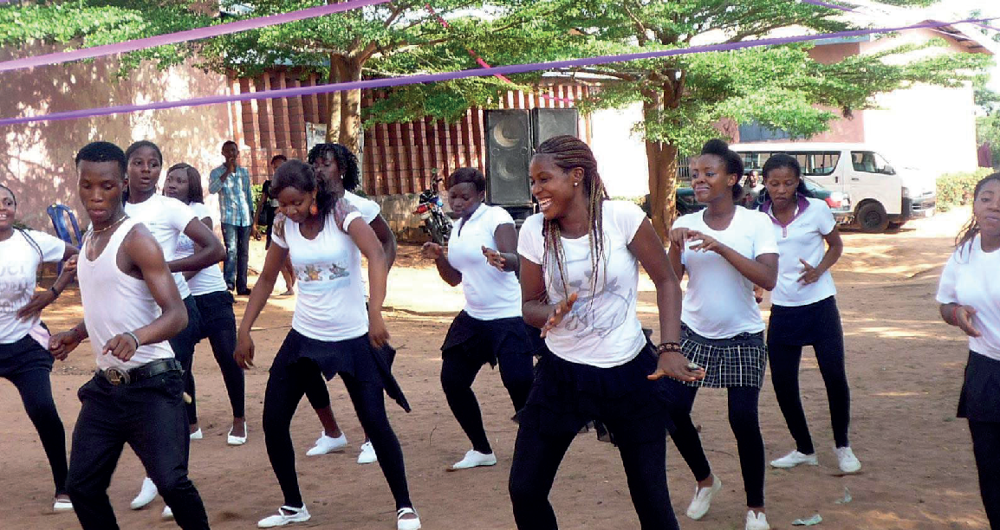
The Grundtvig Institute in Nigeria

Slide 21
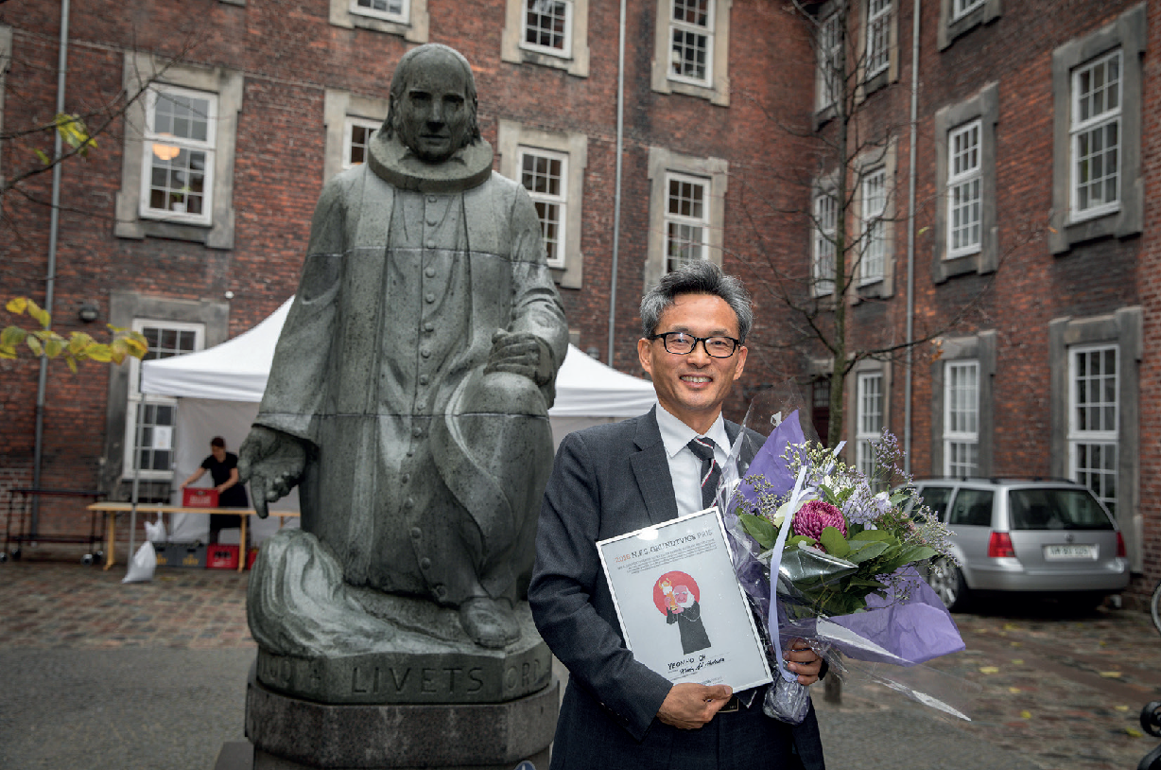

Slide 23
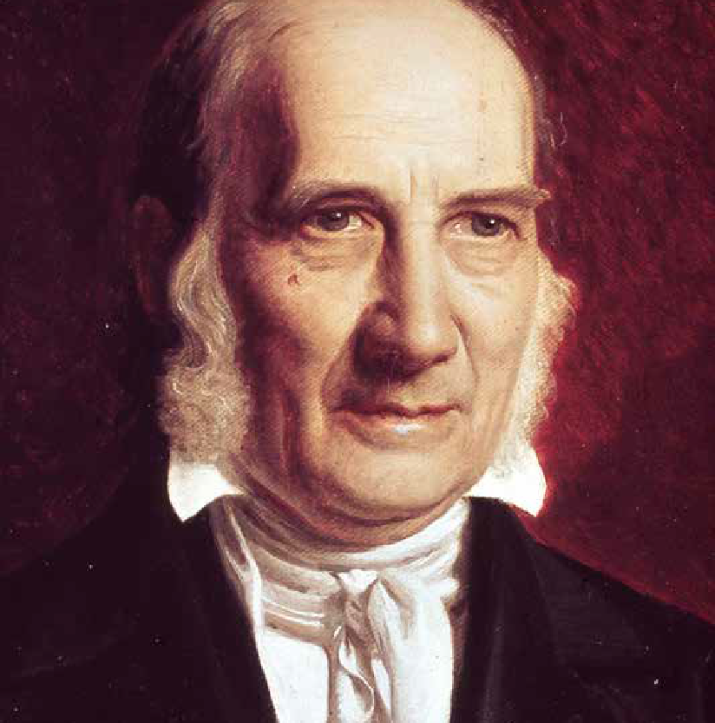
GRUNDTVIG TODAY
Why Does He Matter?

Slide 24
BREAKOUT ROOM QUESTIONS
In your own work, how might Grundtvig’s core ideas influence what you do?
How are Grundtvig’s ideas showing up in today’s folk school/education organizations in your context?
What ideas could be better addressed in today’s folk school/education organization in your context?
What boundaries are created by Grundtvig’s core ideas and do you agree that folk schools/organizations should respect those boundaries?
What ideas, insights, solutions, or methods came out of it?
Why did you think these were significant?

Slide 25
BREAKOUT
ROOM
TIME

Slide 26
QUESTIONS
AND ANSWERS
SESSION

Slide 27
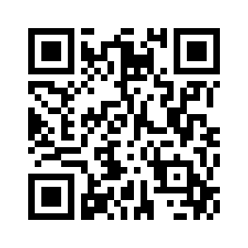
THANK YOU!
SURVEY: Please follow the link in the chat to fill out a quick survey, please help us improve on these webinars by taking a couple minutes and filling it out.
UPCOMING EVENTS:
FSA Community of Practice is September 26th at 8:30am (Pacific Time)
October Webinar (watch for our announcements and invitations to register).
www.folkschoolalliance.org/events
If you did not get a chance to donate at the time of registration, there is still opportunity to do so by making a donation on our website:
www.folkschoolalliance.org/donate

